Slide 1
UT Dallas Software Quality and Software Testing Part 1 – The Big Picture (How Quality Relates to Testing) Part 2 – Fundamental Concepts of Measurement and Data Analysis Part 3 – Defect Containment Part 4 – Measuring Software Structure Part 5 – Measuring Software Complexity

Slide 2
Dennis J. Frailey Retired Principal Fellow - Raytheon Company
PhD Purdue, 1971, Computer Science
Assistant Professor, SMU, 1970-75
Associate Professor, SMU, 1975-77
(various titles), Texas Instruments, 1974-1997;
Raytheon Co. 1997-2010
Adjunct Associate Professor, UT Austin, 1981-86
Adjunct Professor, SMU, 1987-2019
Adjunct Professor, UT Arlington, 2014-present
-----
Areas of specialty: software development process, software project management, software quality engineering, software metrics, compiler design, operating system design, real-time system design, computer architecture
Notes:
MY BACKGROUND IS OVER 30 YEARS IN COMPUTING
MY FIRST JOB WAS WRITING FORTRAN PROGRAMS FOR THE FORD MOTOR COMPANY’S ENGINEERING & RESEARCH CENTER IN DEARBORN MICHIGAN
I AM ALSO ACTIVE IN PROFESSIONAL SOCIETIES SUCH AS ACM, IEEE, AND THE LOCAL GROUP CALLED ASEE, WHICH IS PART OF THE SPIN NETWORK

Slide 3
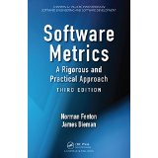
A Recommended Book on Measurement
Some of this material is taken from this book.
Although not a book on testing, it is a very good book on measurement and addresses several aspects of testing.
By Norman Fenton and James Bieman

Slide 4
More Recommended References
SWX – The Software Extension to the Project Management Body of Knowledge, available from PMI (www.pmi.com) and the IEEE Computer Society (www.computer.org).
This is a general reference that may be important if you want to apply some of today’s techniques in project management.
SWEBOK – The Guide to the Software Engineering Body of Knowledge, available from the IEEE Computer Society and also at www.swebok.org
This is another general reference that gives an overall picture of software engineering knowledge and summarizes topics that any software engineer should know about.

Slide 5
Part 1 The Big Picture – How Quality Relates to Testing and Other Aspects of Software Engineering

Slide 6
Test and Evaluation
Evaluation: Appraising a product through one of the following:
Examination, analysis, demonstration
Testing
or other means
Testing: Exercising a system to improve confidence that it satisfies requirements or to identify variations between desired and actual behavior.
“Evaluation” is the broader term.

Slide 7
But What Are We Appraising? What is “Desired Behavior”?
Satisfies requirements
Works correctly
Does what I want it to do
Does no harm
Reliable – I can depend on it
Easy to use
Portable
Easy to update and maintain
Easy to test
Runs efficiently / fast
Consistent
…
Can we test for these characteristics?
Can we measure them?

Slide 8
But What Are We Appraising? What is “Desired Behavior”?
Satisfies requirements
Works correctly
Does what I want it to do
Does no harm
Reliable – I can depend on it
Easy to use
Portable
Easy to update and maintain
Easy to test
Runs efficiently / fast
Consistent
…
These are all characteristics of Software Quality
I.e., testing is one way to assess software quality.

Slide 9
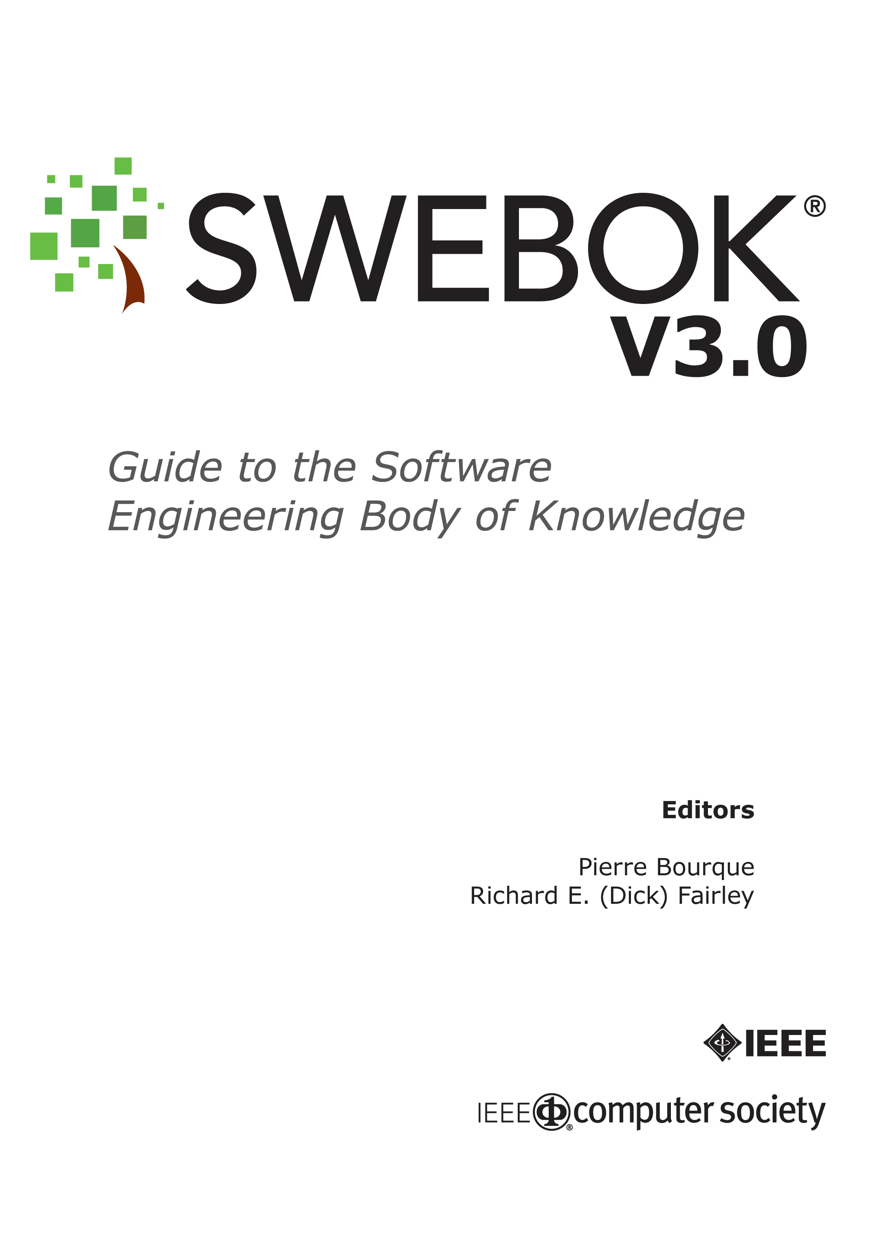
Downloadable at: www.swebok.org

Slide 10
SWEBOK Facts
3 Editions have been produced since 1998
2 Editors: Pierre Bourque and Richard Fairley
8 Contributing and Co-Editors
15 Knowledge Areas, each with its own Editors
Each aligned with related ISO and IEEE standards
9-person Change Control Board
Over 300 reviewers (chosen due to their expertise in various aspects of software engineering)
Over 1500 comments received and adjudicated on various drafts (3rd edition)
36 Items in Consolidated Reference List

Slide 11
The 15 SWEBOK Knowledge Areas
Software Requirements
Software Design
Software Construction
Software Testing
Software Maintenance
Software Configuration Management
Software Engineering Management
Software Engineering Process
Software Engineering Models and Methods
Software Quality
Software Engineering Professional Practice
Software Engineering Economics
Computing Foundations
Mathematical Foundations
Engineering Foundations

Slide 12
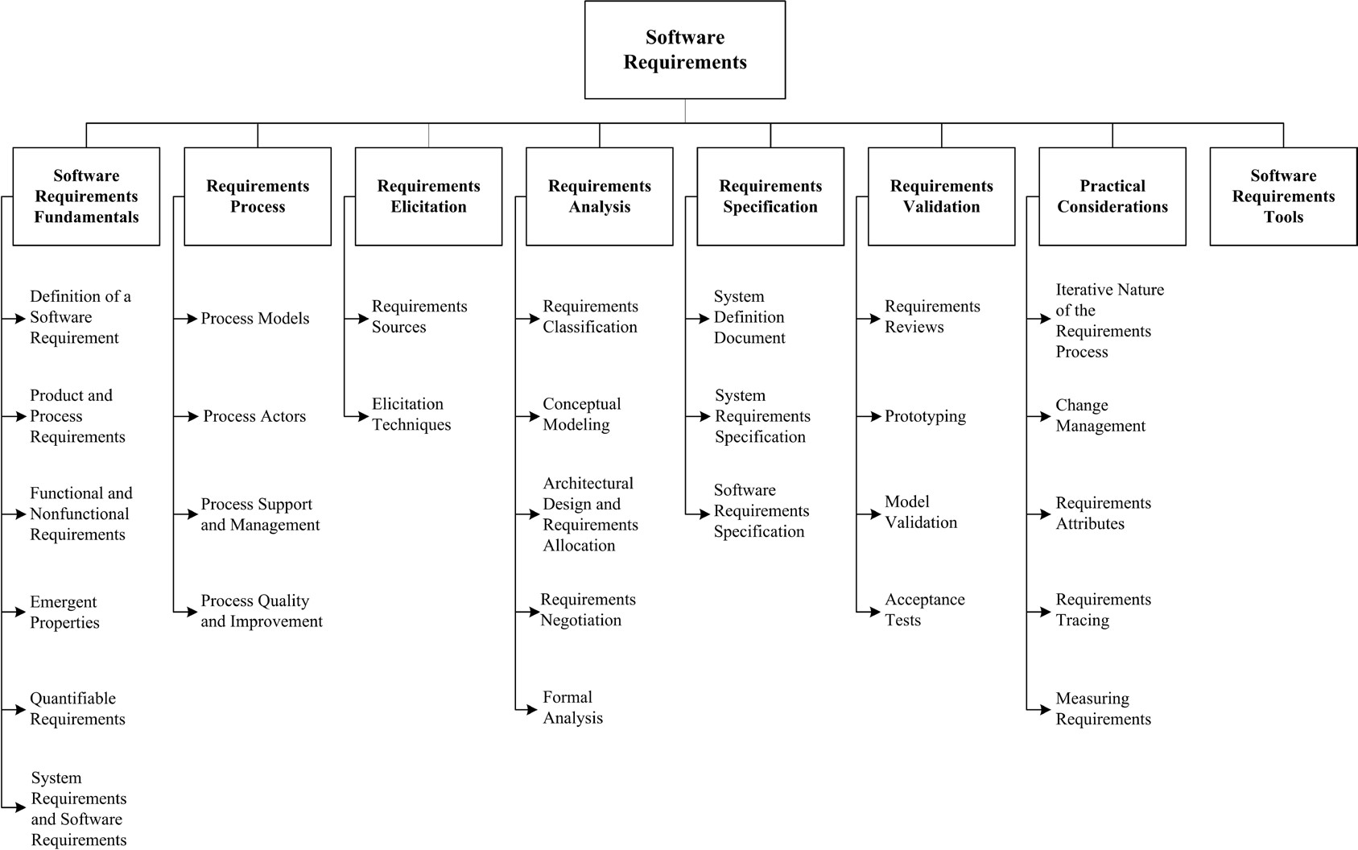
Software Requirements

Slide 13
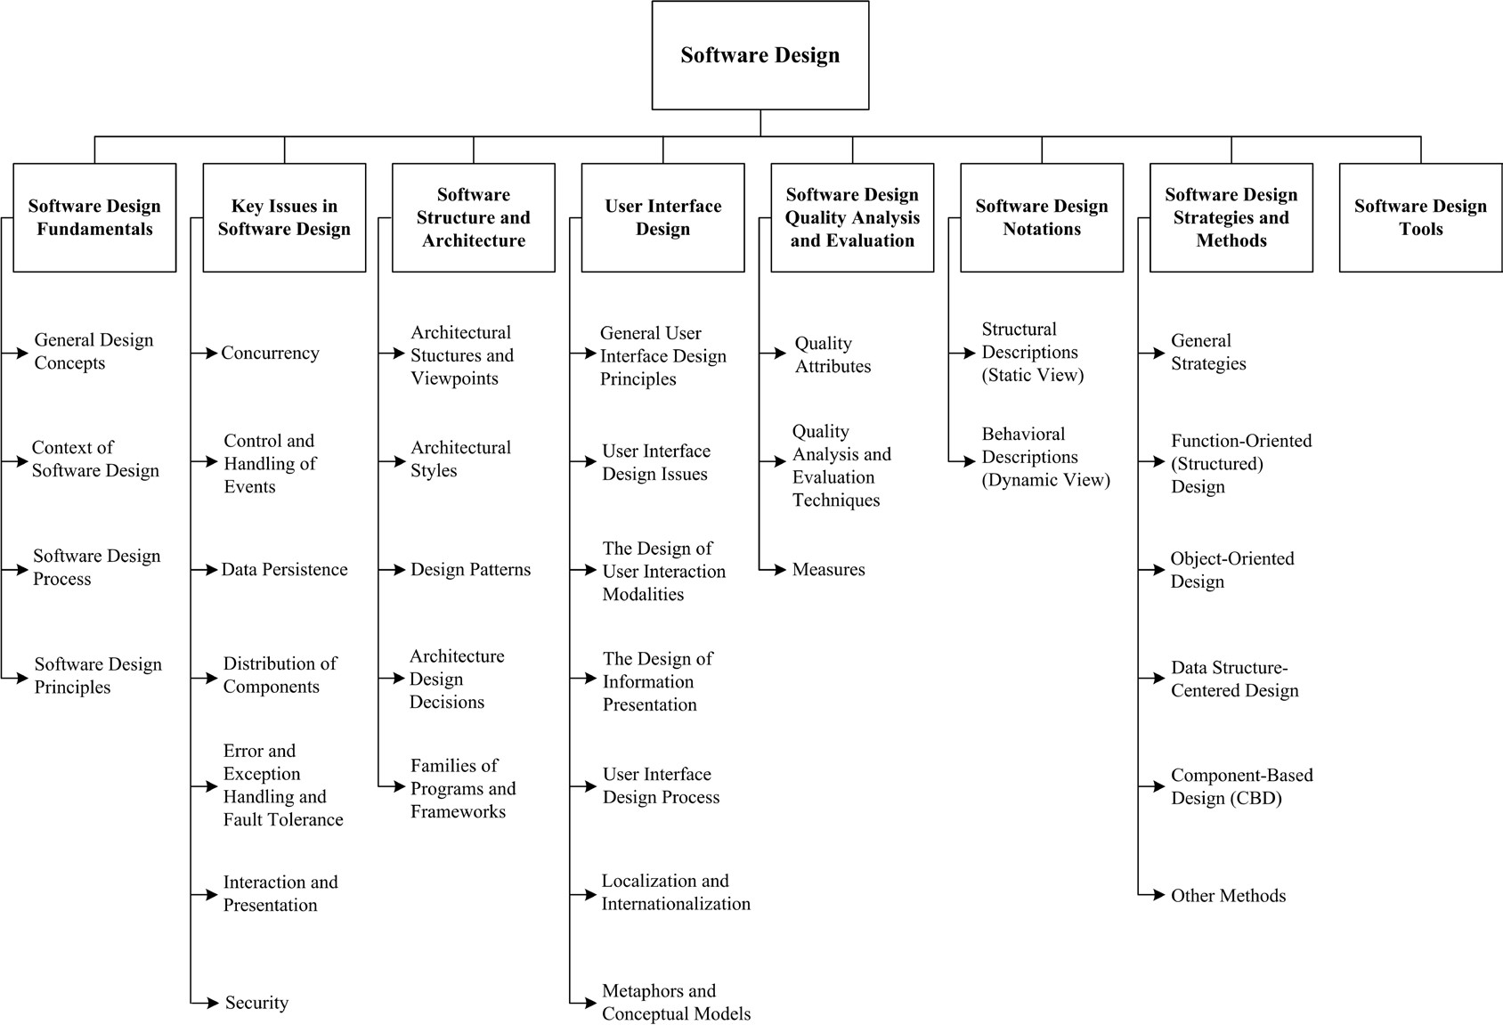
Software Design

Slide 14
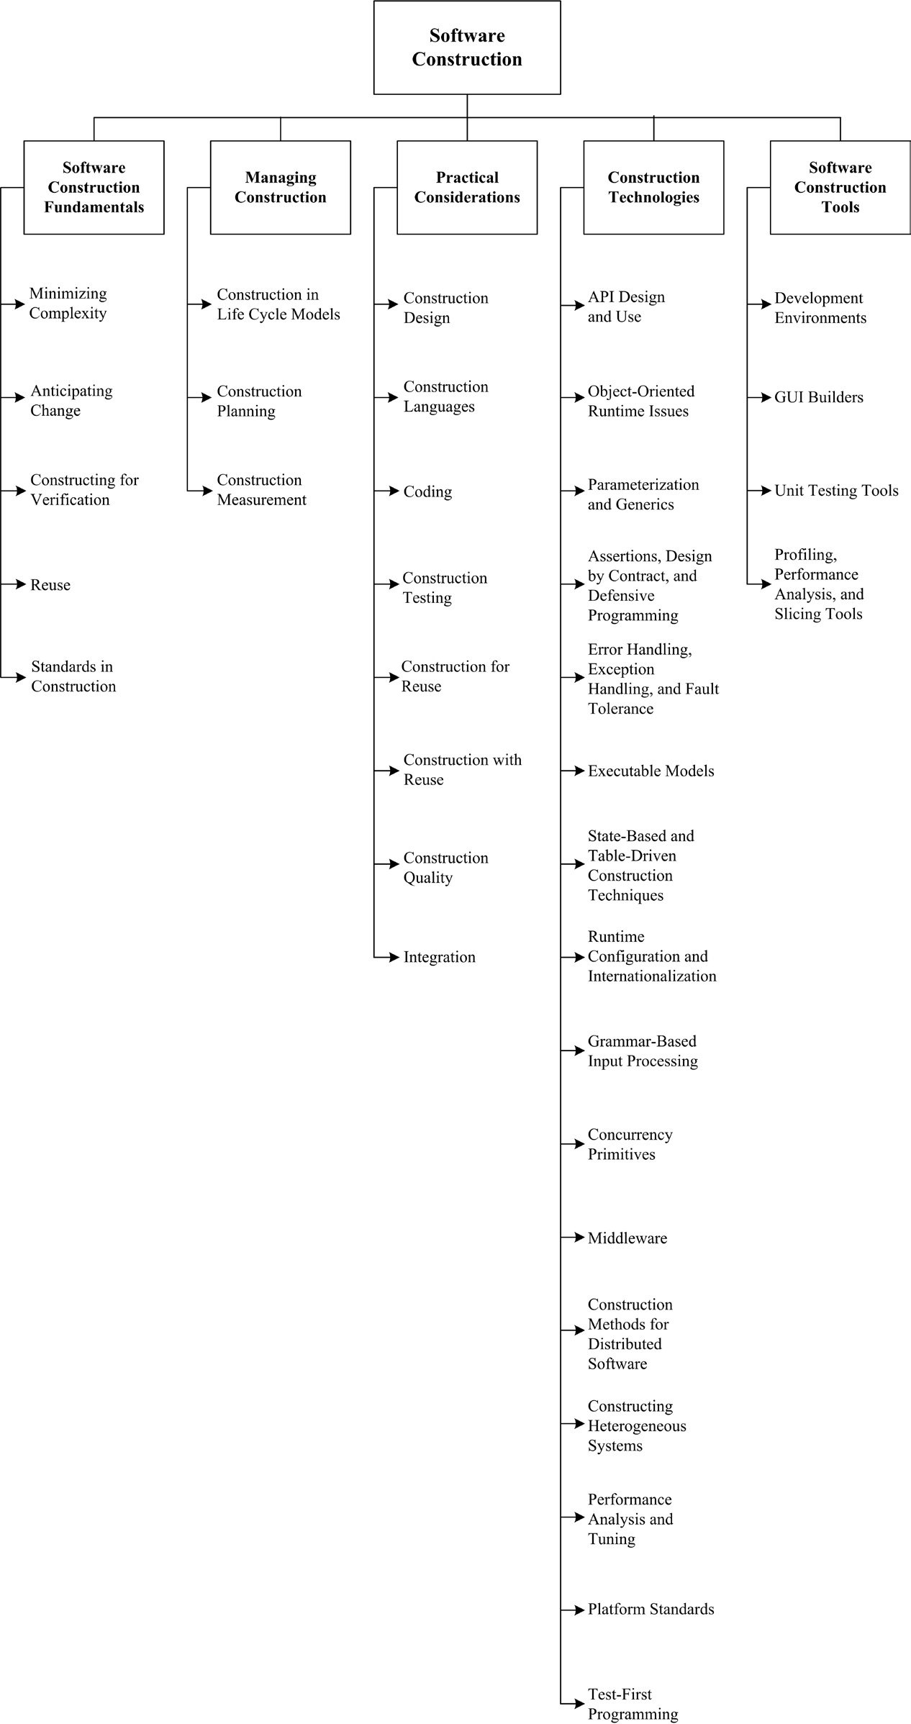
Software Construction

Slide 15
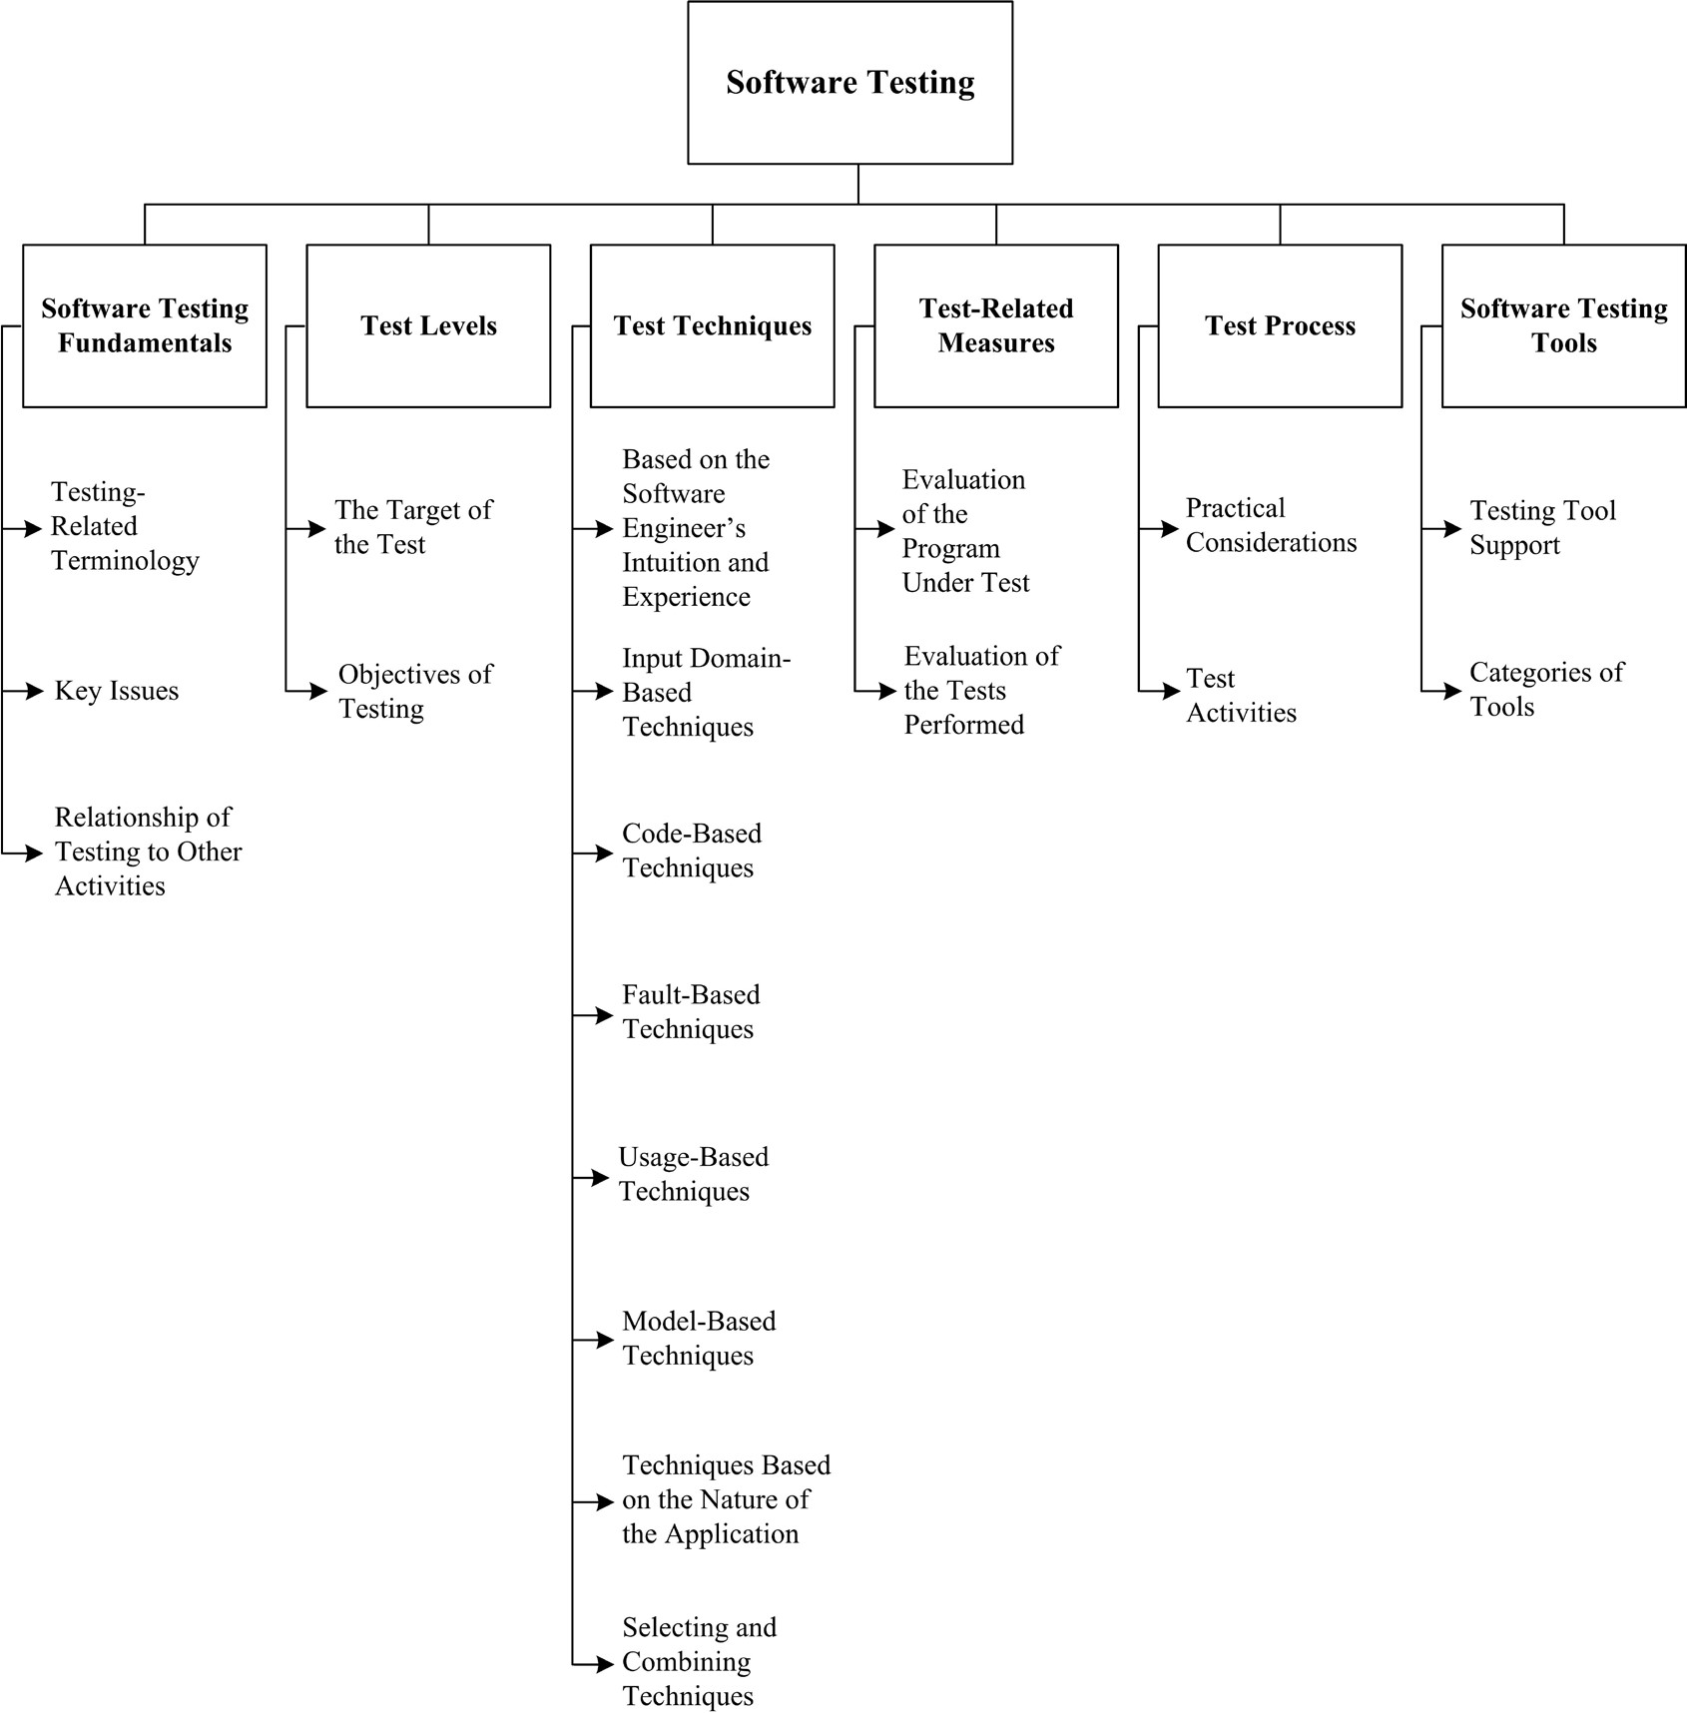
Software Testing

Slide 16
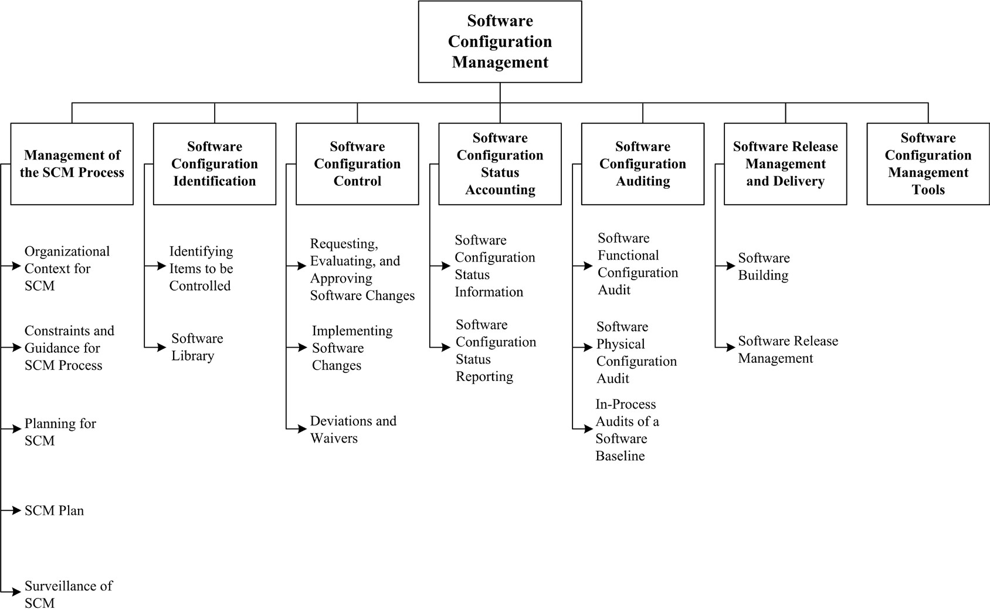
Software Configuration Management

Slide 17
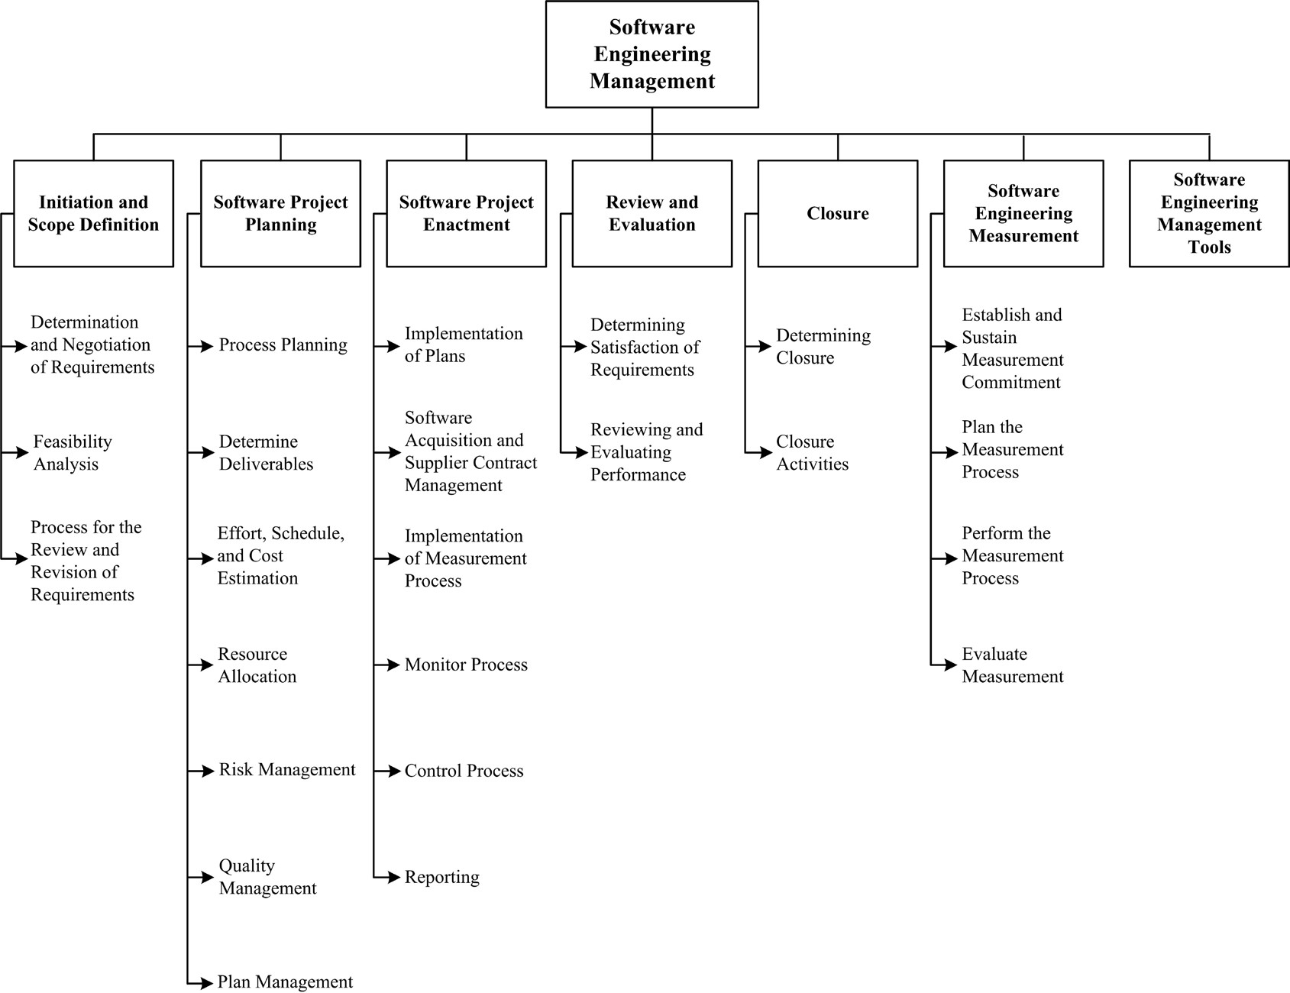
Software Engineering Management

Slide 18
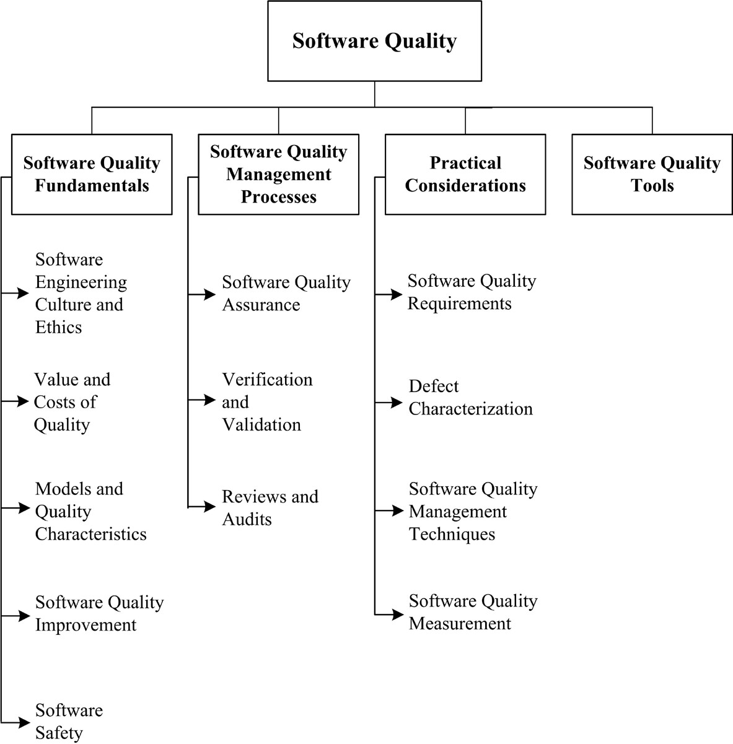
Software Quality

Slide 19

What Do We Mean by Quality?

Slide 20
Concepts of Quality for Products
“Quality is conformance to requirements”
Crosby
“Quality is fitness for intended use”
Juran
“Quality is value to someone”
Weinberg

Slide 21
“Quality is Conformance to Requirements”
If testable requirements can be established, then it is possible to decide whether the product satisfies the requirements – by testing it.
If measurable quality characteristics can be established, then it is possible to decide on the extent to which the product satisfies the requirements – by measuring it.
Thus you can avoid disputes and have workable contractual relationships
However …

Slide 22
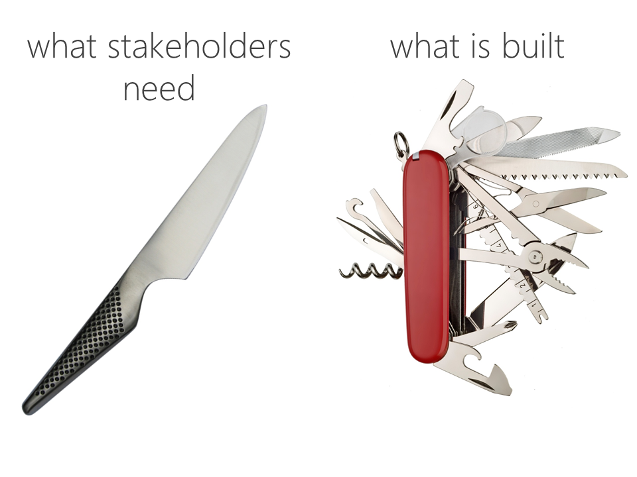
Issues with “Conformance to Requirements” (1 of 4)
Who establishes the requirements?
Sponsor - The one who pays for the product
End User - The one who will use the product
Sales or Marketing - The one who will sell the product
Engineering - The ones who will design and build it
What the end user wants
What the engineer builds
Planetgeek.ch

Slide 23
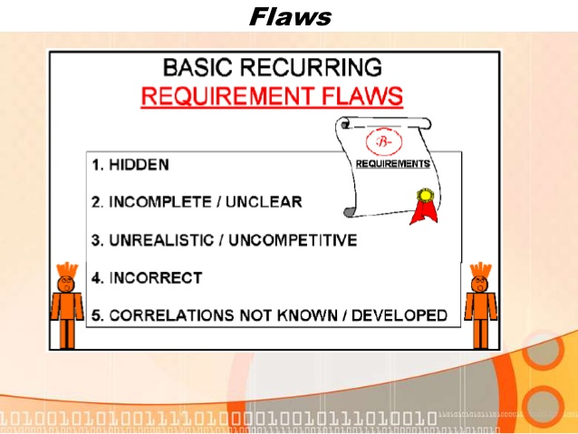
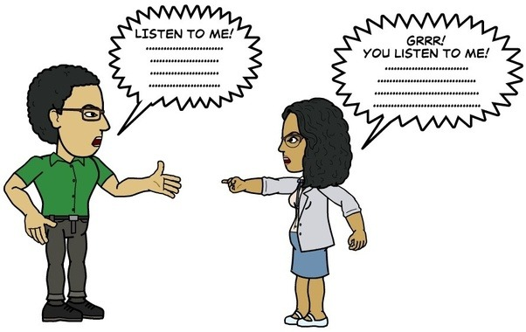
Issues with “Conformance to Requirements” (2 of 4)
Are the requirements right?
consistent
complete
visible
correct
Who determines whether the requirements are right?
What if you discover a problem later on?
Slideshare.net
Quora.com

Slide 24
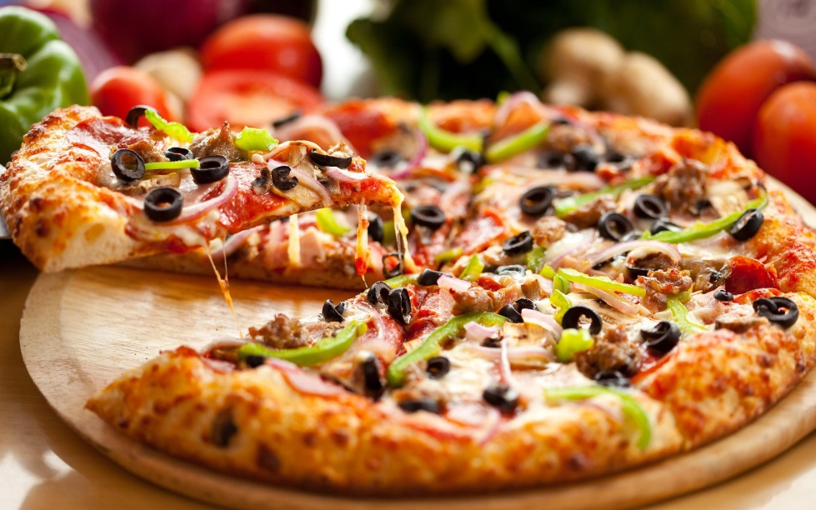
Issues with “Conformance to Requirements” (3 of 4)
What about implicit vs. explicit requirements?
Explicit requirement: pizza should be hot and flavorful
Implicit requirement: not harmful

Slide 25
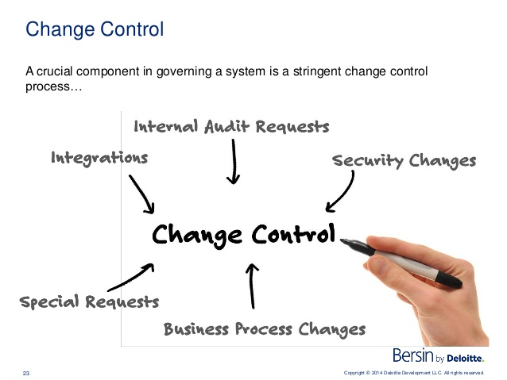
Issues with “Conformance to Requirements” (4 of 4)
What about when requirements change during the development process?
Who makes the changes?
Who controls and authorizes the changes?
Who pays for the consequences of changes?

Slide 26
“Quality is Fitness for Intended Use”
This definition is based on a fundamental concept of law - that a product should be suitable for the use that it is intended for.
This definition accommodates the fact that we may not be able to fully define the requirements.
However …

Slide 27

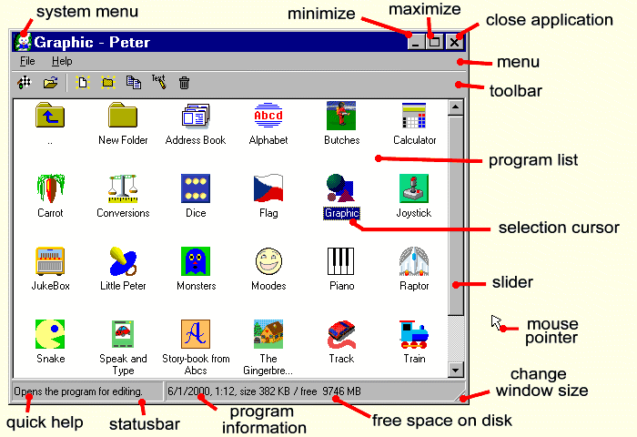
Issues with “Fitness for Intended Use” (1 of 3)
Who defines fitness?
Consider a TV set
which fitness characteristics are not understood by
Typical User
Engineer
Sales Personnel
Consider a software program
which fitness characteristics are not understood by the typical software developer?
Konga.com
Gemtree.com

Slide 28

Issues with “Fitness for Intended Use” (2 of 3)
Different users have different definitions of fitness
Ease of use for novices
Control of fine details for experts
Ease of maintenance for support staff
Able to survive power failures
Compatibility with previous system
Uses change as users grow in experience
Too many “ease of use” and “automatic” features may frustrate an expert
Theodysseyonline.com

Slide 29
Issues with “Fitness for Intended Use” (3 of 3)
The “pleasant surprise” concept
User gets more than he or she expected
They really knew what they were doing when they designed this software
There is often tension between the engineer knowing better than the customer and the customer knowing better than the engineer

Slide 30
“Quality is Value to Someone”
This definition incorporates the idea that quality is relative
And it places increased emphasis on understanding what quality means to the intended user of the software
However …

Slide 31


Issues with “Value to Someone” (1 of 4)
Whose opinion counts?
You may need to weigh different opinions
How is the financial software?
What features do you want?
Can it survive spilled drinks?
I want hot games
Does it have Facebook and Twitter?
Notes:
Example: Word Processor that Only Fails on a Book-Sized Document
Example: Cribbage Game with an Obvious Bug in the Scoring Algorithm

Slide 32
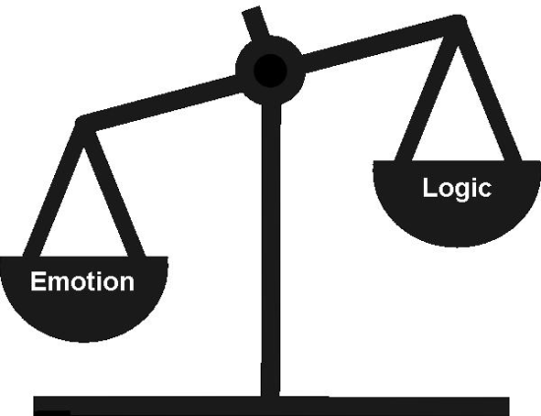

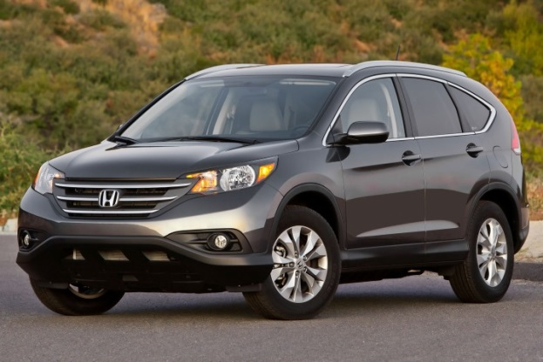

Issues with “Value to Someone” (2 of 4)
Logic vs Emotion
“Glitz” v. “Substance”
Which Car is Best for Our Family?
Notes:
Example: Word Processor that Only Fails on a Book-Sized Document
Example: Cribbage Game with an Obvious Bug in the Scoring Algorithm

Slide 33
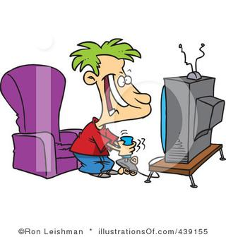
Issues with “Value to Someone” (3 of 4)
Value depends on What Features are Most Important
Space Shuttle
0 defects
Reliability
Video Game
Good user interface
High performance
School Laptop
Rugged
Fast
Good Battery Life
Good Software
Notes:
Example: Word Processor that Only Fails on a Book-Sized Document
Example: Cribbage Game with an Obvious Bug in the Scoring Algorithm

Slide 34

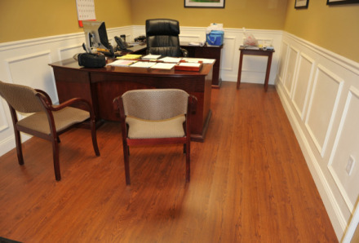
Issues with “Value to Someone” (4 of 4)
Some Needs are Implicit (unstated)
Explicit
Implicit
I need an office
It must have a computer
And lots of space
I need a desk
And a chair
And convenient electrical outlets
Notes:
Example: Word Processor that Only Fails on a Book-Sized Document
Example: Cribbage Game with an Obvious Bug in the Scoring Algorithm

Slide 35
Definitions of Software Quality
IEEE: The degree to which the software possesses a desired combination of attributes
Crosby: The degree to which a customer perceives that software meets composite expectations
Note that both definitions imply multiple expectations

Slide 36
Summary of Quality Definition Issues
You Must Define Quality
Before you can engineer it into your product
… and before you can measure it
… or test whether the product has the desired quality attributes
Quality has Multiple Elements
It reflects a multitude of expectations
Quality is Relative
Quality is in the eye of the customer
Quality encompasses fitness, value, and other attributes

Slide 37
Quality Attributes are Seldom Directly Measurable
Fitness for intended use
Value to someone
Satisfaction of requirements
Including implicit, unstated requirements
Maintainability
Reliability
Supportability
Testability
…
How can these be measured?
We need to find suitable ways to measure these attributes.

Slide 38
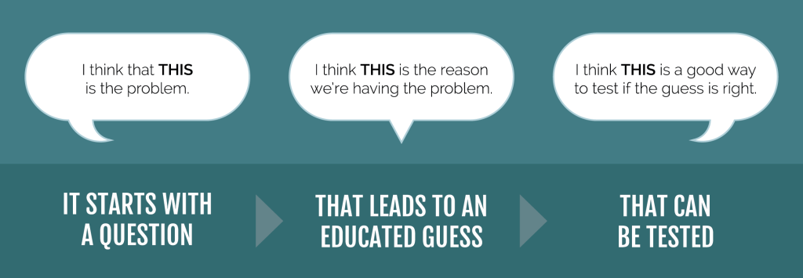
Some Attributes Are Measurable
Examples
Water boils at 100º Centigrade
My new application will complete at least 10 searches per minute
Code written in C takes less memory space than code written in Python
The above statements may or may not be true, but they can all be tested because they are all measurable.
Elicitinsights.com

Slide 39
Some Attributes are Not Measurable
Examples:
Joe’s code is better than Jan’s code
Lisp is a superior programming language to C#
Object oriented design produces code that is more maintainable
The above cannot be measured unless we define what we mean by:
Better than
Superior
Maintainable
In a measurable way!

Slide 40
Surrogates
In order to measure an un-measurable attribute
such as “quality” or “maintainability”
We may need to measure indirectly
we measure something else that is associated with that attribute
such as “defects” or “repair cost”
This alternative, measurable attribute is called a surrogate.

Slide 41
Surrogates Are Not the Real Thing
A surrogate may or may not accurately reflect the desired attribute
Examples:
Defects are a common surrogate for quality
But defects may or may not reflect quality.
Defects may reflect failure to do effective testing
Or failure of the customer to use the product
Repair cost may or may not reflect maintainability of the software
Perhaps “repair” included many changes to the software to add new features
Or perhaps the maintenance staff are not competent

Slide 42
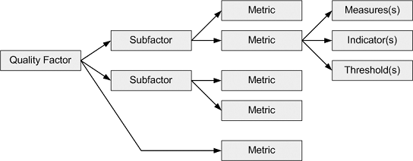
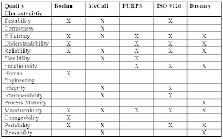
There Are Systematic Ways to Identify Surrogates
Decomposition Approaches
Fixed models
Individualized models
Standardized Approaches
These enable comparisons of software from different organizations
But may not fit the desired quality characteristics of some software
Bvicam.ac.in
There is little consensus on how to measure quality attributes, so most organizations define them in ways that fit their specific customer needs.

Slide 43
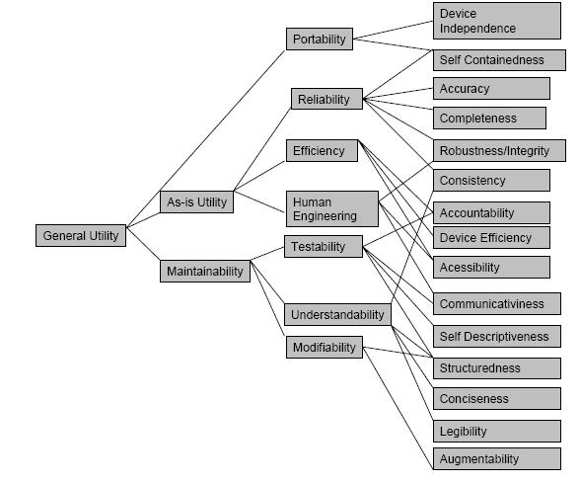
Decomposition Approaches Boehm Software Quality Model
The concept here is to decompose quality attributes or factors into subfactors until you find factors that are measurable.

Slide 44
A Closer Look at the Boehm Model
Quality
Factors
Measurable Quality Criteria
Primary Uses
General Utility
Portability
Device Independence
As-is Utility
Reliability
Completeness
Efficiency
Accuracy
Human Engineering
Consistency
Maintainability
Testability
Understandability
Fenton’s Terminology
Modifiability

Slide 45
Comments on Boehm’s Model
This is a way to decompose what we mean by “quality” until we have measurable attributes (quality criteria)
These quality criteria are surrogates for quality
There are many of them
Some of them relate to multiple quality factors
Quality
Factors
Measurable Quality Criteria
Portability
Reliability
Completeness

Slide 46
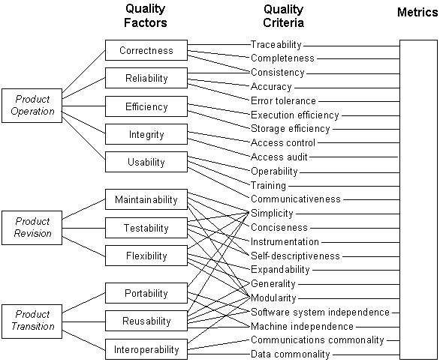
Decomposition Approaches McCall Software Quality Model
As you can see, it’s possible to establish a lot of criteria related to quality

Slide 47
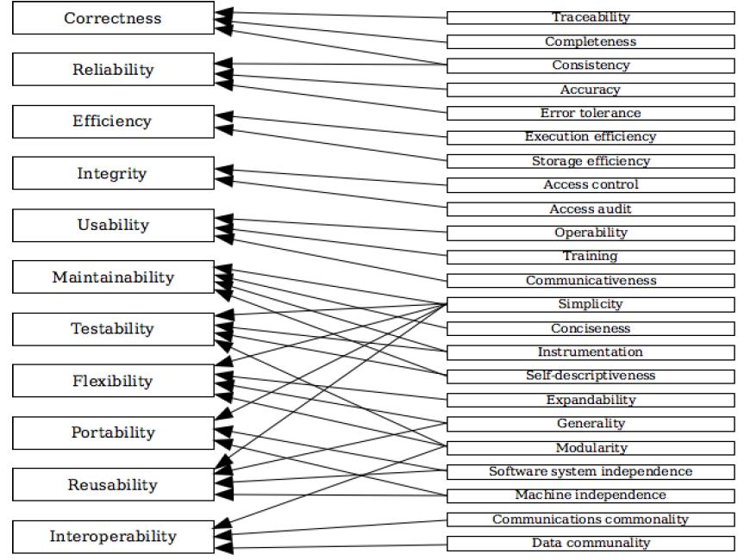
McCall Model – Quality Factors and (Measurable) Criteria
As with the Boehm model, some criteria relate to multiple quality factors

Slide 48
Do I Really Need to Measure So Many Attributes?
The various models tend to be comprehensive
But you may need to use only a portion of a model for your specific situation
Ultimately you need to measure only what will actually be used and be useful

Slide 49
Measures of Software Quality Based on Defects or Faults or Failures

Slide 50
Quality = Lack of Defects (or Lack of Faults or Lack of Failures)¹
The advantage of this approach is that it is often easier to test for defects or failures and easier to measure them
than many other measures of quality
However this approach may not capture what quality means to the end user
Ease of use
Speed
…
And it may not reflect all that the developer considers important
Maintainability
Supportability
…
¹ Defects and faults usually mean the same thing – causes of failures.

Slide 51
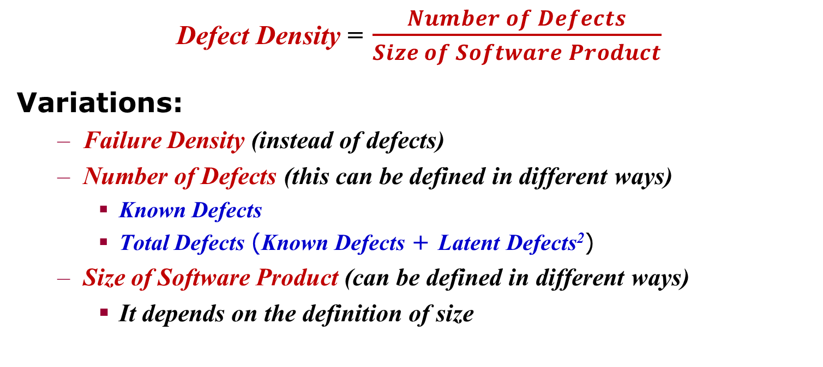
Defect Density¹
Defect Density = $\frac{Number of Defects}{Size of Software Product}$
Variations:
Failure Density (instead of defects)
Number of Defects (this can be defined in different ways)
Known Defects
Total Defects (Known Defects + Latent Defects²)
Size of Software Product (can be defined in different ways)
It depends on the definition of size
¹ Sometimes called “defect rate”, although this is inaccurate
² Latent defects are defects we have not yet discovered

Slide 52
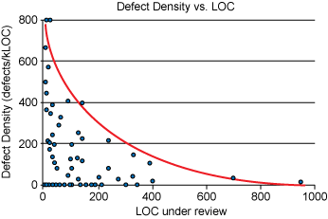
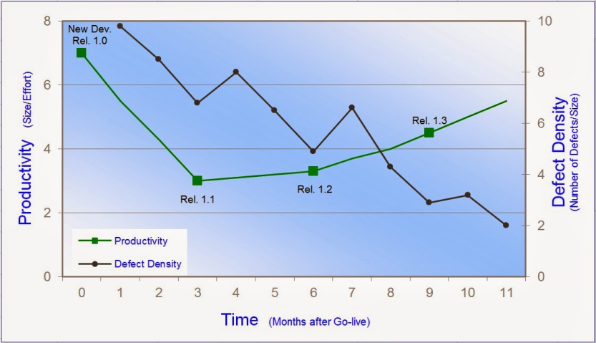
Defect Density Advantages
Easily measured, compared with other options
Gives a good, general idea of the overall quality of the software
This measure has been used for over 50 years to measure software, and overall the defect density has correlated well with perceived quality of products

Slide 53
Defect Density Drawbacks (1 of 3)
People can’t always agree on what constitutes a defect
Failure in operation vs mistake in the code
Post-release defects vs defects found during development
Discovered vs latent defects
Severity of problems caused by defects may be hard to assess
Some software defects have no significant impact on customer’s perception of quality
Different customers use the software in different ways

Slide 54
Example from IBM¹
Approximately one out of three defects will only cause a user failure once in 500 years.
A very small portion of defects (<2%) cause the most important user failures
Number of defects may not be strongly correlated to the frequency or severity of end user failures.
¹ See Adams in reference list.

Slide 55

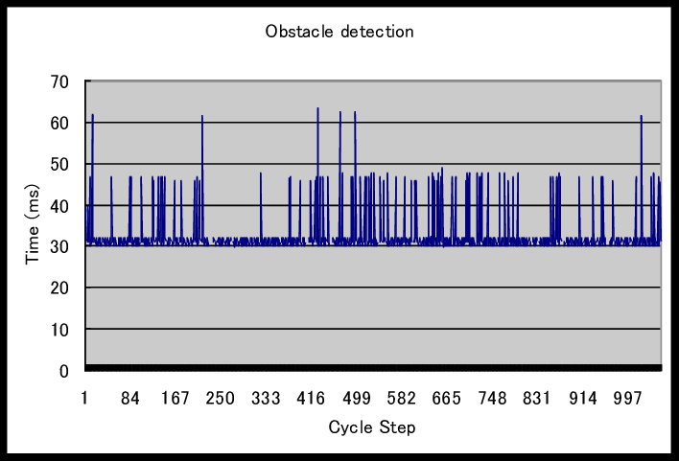
Defect Density Drawbacks (2 of 3)
Different measures of the time scale
Amount of time since release of product
Amount of time the product is actually used
Processing time actually used by the product
Release
Purchase
Installation
First Use
First Failure
Jan | Feb | Mar | Apr | May | Jun | Jul | Aug
No problems with the software?
Not yet.
But we only use it once a year.
Researchgate.net

Slide 56
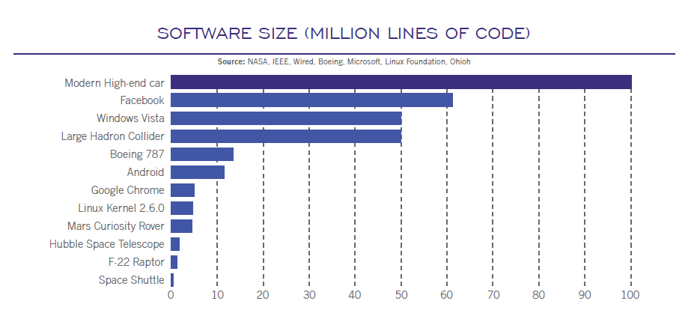
Defect Density Drawbacks (3 of 3)
Different measures of size
This can make it hard to compare different projects or processes or development methods or organizations
What is defect density telling us?
The quality of our product?
or
The effectiveness of our defect detection and correction process?

Slide 57
Despite These Drawbacks, Defect Density is Very Widely Used
Some metrics that incorporate defect density
Cumulative defect density
During development or after delivery
Total serious defects found
Mean time to fix serious defects
Defects found during design reviews per KLOC
Code inspection or peer review defects found per KLOC
System test errors found per KLOC
Customer-discovered problems per KLOC or per product

Slide 58
Usability Hard to Test For & Hard to Measure
Formal Definition:
Usability is the degree to which a system can be used by specified users to achieve specified goals with effectiveness, efficiency and satisfaction in a specified context of use.
ISO/IEC 25010 (2011)
Commonly used concepts of usability:
User Friendliness
Ease of use
This is a very complex concept that is hard to measure, but important to most end users

Slide 59
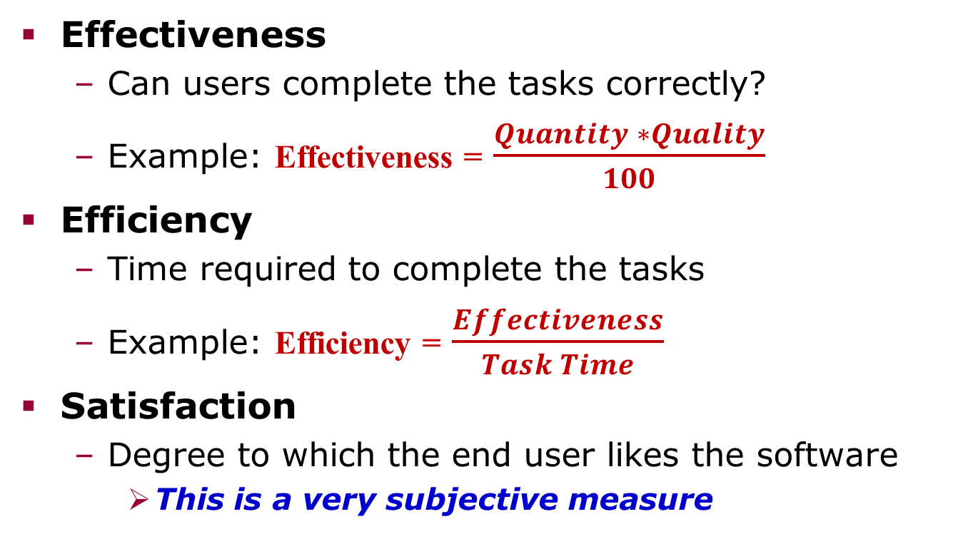
Three Categories of Usability¹
Effectiveness
Can users complete the tasks correctly?
Example: Effectiveness = $\frac{Quantity ∗Quality}{100}$
Efficiency
Time required to complete the tasks
Example: Efficiency = $\frac{Effectiveness}{Task Time}$
Satisfaction
Degree to which the end user likes the software
This is a very subjective measure
¹ See Fenton, section 10.3 for further details

Slide 60
Internal Attributes Generally Viewed as Related to Usability
These are more readily measured and
can be measured before the software is released
Good use of menus
Good use of graphics
Good help functions
Consistent interfaces
Well-organized reference manuals
Researchers have been unsuccessful in relating these to effectiveness, efficiency or customer satisfaction.
Use of these to predict usability is not recommended.

Slide 61
Testability
A product is testable if:
It can be tested in a reasonable way (readily testable)
The tests are well defined, comprehensive, and not overly redundant
Each test can be directly traced to and from:
product requirements,
derived requirements resulting from design decisions, or
design or coding elements calling for specific testing
Each test failure can be directly traced to:
a requirement that is not being met, or
A design element that was not properly implemented, or
A portion of the code that has a programming error
Good testing starts with testable requirements and designs.
Notes:
Traceability from requirements is important, not just to requirements.
If you change a requirement, you need to know what tests need to be updated and/or rerun.
Derived requirements are requirements that result from your specific design or solution
requirement: deliver a computer with a given application capability
derived requirement: you must have 8 million bytes, because you are using a specific operating system and processor

Slide 62
Testing is unsuitable when ...
It would destroy the product
It is too dangerous
It is too costly
It cannot reasonably be expected to provide confidence that requirements are satisfied
It cannot be done
Notes:
Example: testing an air bag destroys the air bag
Example: testing that a nuclear reactor is safe under extreme circumstances might risk meltdown
Example: testing that software responds correctly to an odd interrupt might require building expensive test equipment
Example: if the software is too complex, no tests may be adequate -- in fact, testing is never adequate to guarantee absence of errors - we’ll discuss this more later

Slide 63
Evaluation Techniques (other than testing)
Examination
For example, reading designs or code or other documents to check for errors
Demonstration
e.g. flying an airplane to show that it can fly
e.g. running a program to show that it works
Other techniques (examples)
providing a formal proof that a program is correct
measuring something
showing through statistical analysis that the probability of a defect is below a threshold

Slide 64
Reasons why Requirements/Designs May be Hard to Test
Requirements may not be well understood
Requirements may not be well documented
What seems obvious to the customer or the system designer may not seem clear or obvious to the software developer or tester
Different kinds of knowledge
Unstated assumptions
The customer and the software developer may not agree on what constitutes an acceptable test
Changes made during software development may not be communicated to the software team

Slide 65

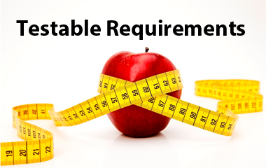
Suggestions (slide 1 of 3)
A requirement or design feature is not complete until you have reached agreement on how it is to be tested
For each requirement, reach agreement between the software team and the customer or system engineer on how the requirement is to be tested
For each design feature, reach agreement between the software designer and the software test team on how the design feature is to be tested
www.cigniti.com

Slide 66
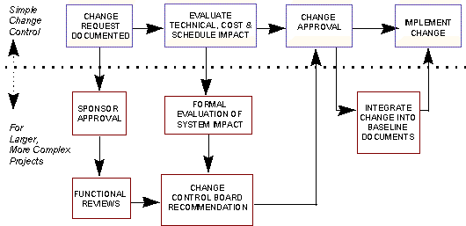
Suggestions (slide 2 of 3)
Control changes to requirements and design
Don’t allow a requirements or design change without a clear understanding of the effect of the change on the software cost, schedule and technical development
For each change to requirements or design, indicate how the corresponding tests must be changed.
Researchgate.net

Slide 67
Suggestions (slide 3 of 3)
Keep track of which tests correspond to which requirements or design elements (traceability)
Ideal
Requirement 1 Test 1
Requirement 2 Test 2
Requirement 3 Test 3
Acceptable
Requirement 1
Requirement 2 Test A
Requirement 3

Slide 68
Other Traceability Options
Acceptable
Test 1
Requirement A Test 2
Test 3
Undesirable
Requirement 1 Test A
Requirement 2 Test B
Requirement 3 Test C
Notes:
Ideal 3 works sometimes with very complex products that have relatively simple requirements.
Less than ideal should be minimized. Drawbacks include:
Harder to trace
Harder to test
Changes have greater impact
Geometric Growth of combinations to test and interfaces to check out

Slide 69
Reasons Why Code May Be Difficult to Test
Code is not well structured
Needlessly complex
Poorly organized
Code elements do not trace directly to requirements or design elements
So when the code causes a failure, it is hard to determine whether the problem is with the code or the design or the requirement
Code is not well documented or does not follow coding conventions
Hard to understand
Error prone
We will address this in parts 4 and 5

Slide 70
Seeding and Tagging A way to assess Testing Progress

Slide 71
Seeding and Tagging
Purpose: To help you estimate how many undetected errors (defects) are in your code
When to do this: During test planning and during the testing process
Suppose: You have been testing your code and have discovered D₁ errors (defects).
Question: How many errors are left?
Technique: Seeding and Tagging
Concept: Introduce extra errors and see how many of them your test process has found.

Slide 72
Seeding and Tagging Details
Introduce a given number of extra errors into the software -- say E of them
Run standard tests, detecting D₂ of them
Compute D₂/E = % of errors detected
Suppose D₁ = number of genuine errors already detected
Then you assume the total number of errors in the software is
D₁*E/D₂

Slide 73
Example of Seeding and Tagging
200 defects found so far
You have injected 20 extra defects
You have found 12 of these extra defects
Therefore, assume total defects =
200 * 20 / 12 = 4000 / 12 = 333 total defects
=> 333 - 200 = 133 defects remaining
By performing this analysis from time to time, you can estimate your defect density and your testing progress over time.

Slide 74
Part 2 Some Basic Principles of Measurement and Data Analysis

Slide 75
Contents
Definitions
Scales
Basic Analysis Approaches
Statistical Distributions
Other Statistical Concepts

Slide 76
Measurement is ...
Definition of Measurement
... the process by which numbers or symbols are assigned to attributes of entities in the real world in such a way so as to describe them according to clearly defined rules.
The assignment of numbers must preserve intuitive and empirical observations about the attributes and entities
Source: Fenton, page 5

Slide 77
Preservation of Attributes Example
“House A is bigger than House B”
This is a meaningful statement only if the number we assign to “size” preserves our intuitive notion of houses and their sizes.
House A
House B

Slide 78
But Intuitions Vary
What do we really mean by “size”?
Before we can measure size, we must define a model that reflects a specific viewpoint
The model must specify an entity to be measured
and
an attribute of that entity.
I.e.,
what do you want to measure? and
what do you want to know about it?
Examples (next two slides)

Slide 79
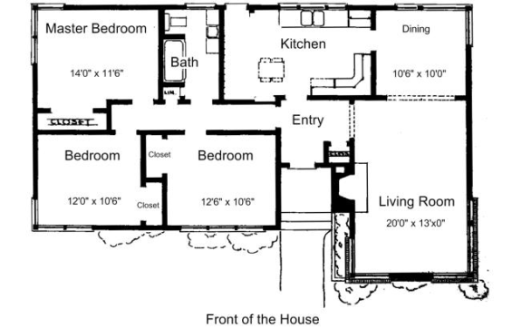
Functionality Model for Size of a House
In this model, the size of a house is based on how many people can comfortably live there
The size of a house is measured by the number of bedrooms and the number of bathrooms

Slide 80
Cost Model for Size of a House
In this model, the size of a house is based on how much it will cost to construct it
The size of a house is measured by the square feet of living space

Slide 81
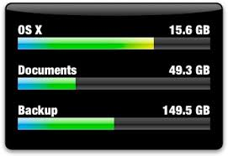
Storage Space Model for Size of Software Used on a PC
In this model, the size of software is based on how much disk space it occupies
The size of software is measured by the number of bytes of memory it requires when stored on a disk
https://encrypted-tbn2.gstatic.com/images?q=tbn:ANd9GcSGaF3LbJOReKic-6yZyOr9_cKS3Lr3gV0zzEX9rsMezUxHinFliw

Slide 82
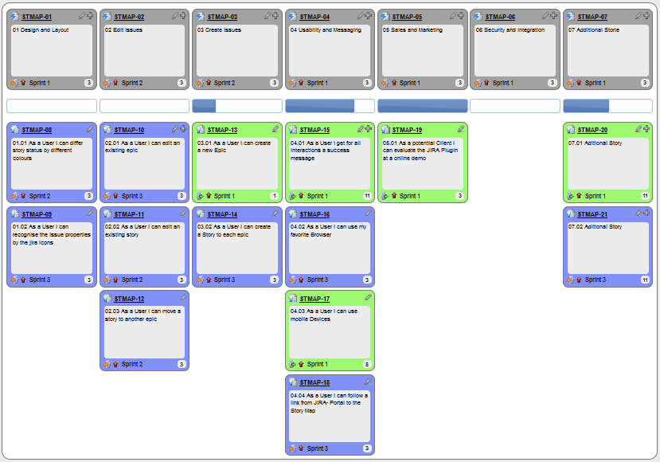
Cost Model for Size of Software Used on a PC
In this model, the size of software is based on how much it will cost to construct it
The size of software is measured by the number of user stories used to establish the requirements.
https://www.google.com/url?sa=i&rct=j&q=&esrc=s&source=images&cd=&cad=rja&uact=8&ved=0ahUKEwikptj9kdfSAhWKz4MKHfSNAfEQjRwIBw&url=https%3A%2F%2Fen.wikipedia.org%2Fwiki%2FUser_story&bvm=bv.149397726,d.cGc&psig=AFQjCNFdWIGXMDrGnfsbmrgiNdbLFEGADg&ust=1489620239765305

Slide 83
Contents
Definitions
Scales
Basic Analysis Approaches
Statistical Distributions
Other Statistical Concepts

Slide 84





Measures Allow Us to Categorize and Analyze the Attributes of Entities
But measures do not have to be numbers.
Example: Road Signs – shape and color are used to categorize road signs
Warning
Information

Slide 85
Definitions: Scales of Measure
A scale of measure
or
A level of measurement
or simply
A scale, is:
A collection of symbols or numbers used to classify attributes of entities or variables
A classification system for describing the nature of information
There are various scales in use and the properties of those scales are important
The properties help determine which forms of analysis are appropriate

Slide 86
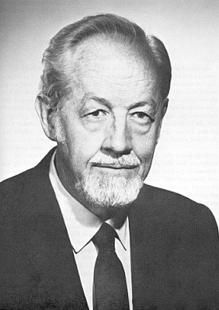
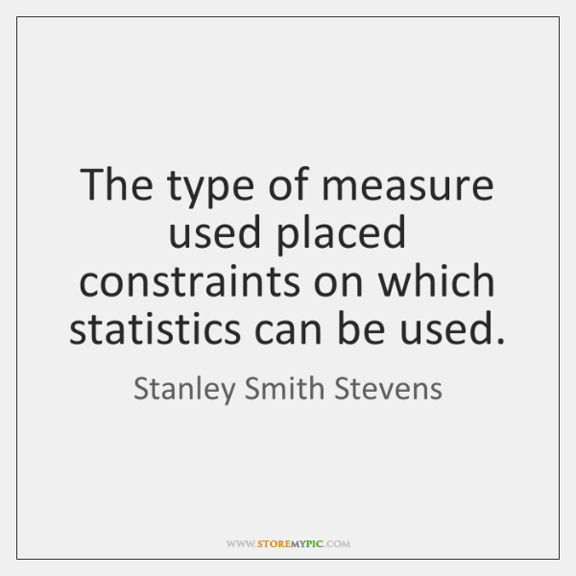
Classification of Scales
The classification system most widely adopted in data analysis and statistics was originated by Stanley Smith Stevens¹ for use in psychological research.
This classification includes four levels of scales:
Nominal
Ordinal
Interval
Ratio
www.fixquote.com
Researchers have debated Stevens’ classification and proposed other classification systems, but no other scale classification has achieved such widespread use.
www.storemypic.com
¹Stevens, S. S. (7 June 1946). "On the Theory of Scales of Measurement". Science. 103 (2684): 677–680.

Slide 87
Stevens’ Types of Scales
Analytically Useful Characteristics
Nominal
Ordinal
Interval
Ratio
Scale

Slide 88

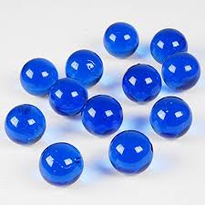
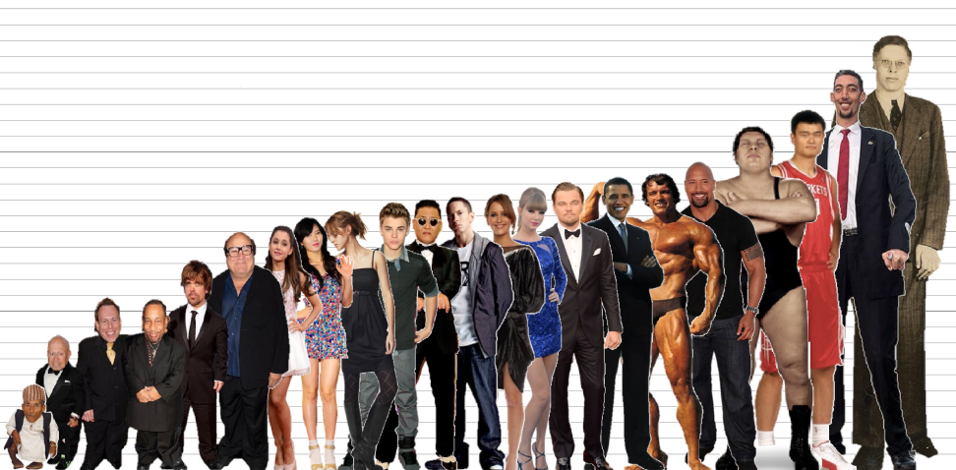
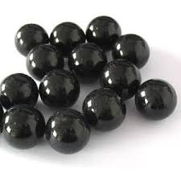
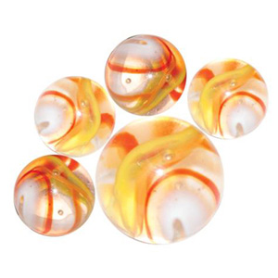
Scales Help Us Understand What Kinds of Analysis are Meaningful
Height
Natural Order
Color
No Natural Order

Slide 89
Nominal Scales
Characteristics
Nominal
Ordinal
Interval
Ratio
Scale

Slide 90
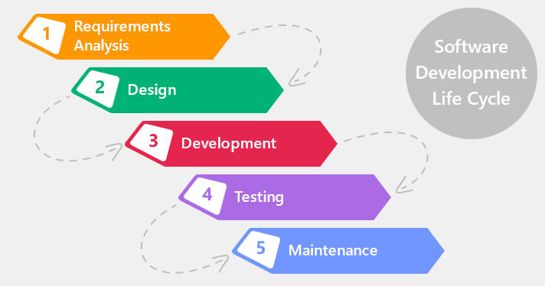
Nominal: a scale that places entities in categories – but without any ordering
Example: Color
– marbles are
Blue, or
Black, or
Red, or
Yellow
Software Example: Defect Origin
- defects discovered while testing are
Requirements related, or
Design related, or
Development related, or
Testing related.
www.xbsoftware.com

Slide 91
Nominal Scales - Characteristics
We can categorize the entities
Often in terms of specific qualities such as color or shape
We can count the size or frequency of each category
We can determine the most frequent category (the mode)
But there is no natural order or ranking to the categories
And there’s no such thing as the median or average

Slide 92
Other Examples of Nominal Scales
Gender
Nationality
Ethnicity
Language
Genre
Style
Biological Species
Form or Shape
Parts of Speech (in grammar)
We can use numbers to classify attributes or variables in a nominal scale
But they do not have any numerical values or relationships other than equality or inequality

Slide 93

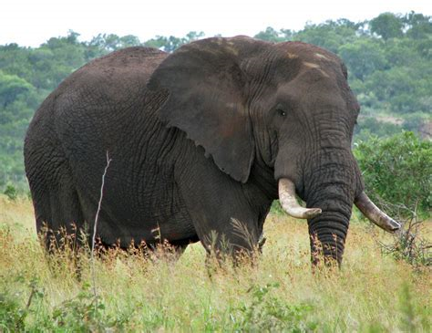
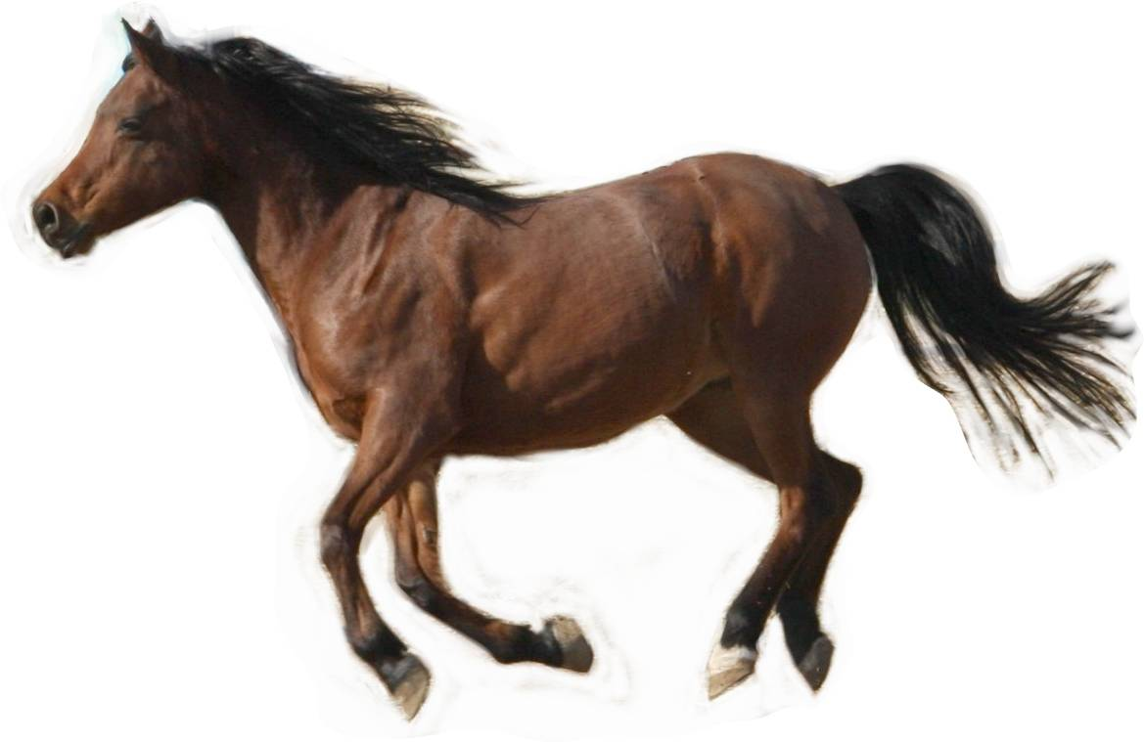
Example: Suppose We Have Three Animal Species
Tigers
Elephants
Horses
Just because we have numbered them in a particular order does not mean anything.
Mynicetime23.wordpress.com
Tigers are not more important because they are listed first
True-wildlife.blogspot.com
Horses are not 3 times as valuable because we gave them the number three
kidssearch.com

Slide 94
Ordinal Scales
Characteristics
Nominal
Ordinal
Interval
Ratio
Scale

Slide 95
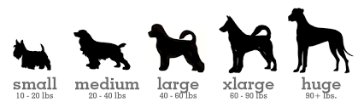
Ordinal: there is a ranking or ordering
Example: military rank
General
Colonel
Lieutenant
Sergeant
SW Example: defect severity
minor
significant
major
Example: size of dogs
https://cdn.shopify.com/s/files/1/0118/8082/files/dog_sizes_antler.png?373

Slide 96
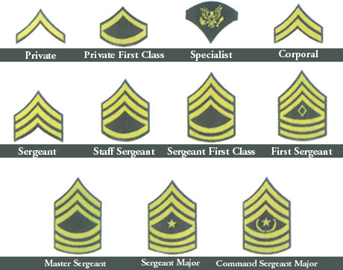
Ordinal Scales - Characteristics
You can place them in order (sorting)
You can determine the median (middle) item in a list
But you cannot compute an average
And there is no mathematical relationship between categories
(sergeant is not “twice as” high as “private”)

Slide 97
Ordinal Scales – Other Examples
Rank in a contest or race
Degree of health
Critical Serious Fair Good Excellent
Comparative restaurant ratings
Excellent Very Good Good Poor Terrible
The degree of distance between successive categories is not defined
You can determine the middle item (median) but not the “average” (mean)

Slide 98
Interval Scales
Characteristics
Nominal
Ordinal
Interval
Ratio
Scale

Slide 99
Interval: there is a fixed distance between consecutive members of a sequence
Given any two dates, we can count the distance between them in days
Example: Dates
1/1/2012, 1/2/2012, …
Example: Temperature in Farenheit
10 degrees, 30 degrees, etc.
Given any two temperatures, we can count the distance between them in degrees

Slide 100
Interval Scales - Characteristics
There is an ordering
You can quantify the distance (degree of difference) between any two values
You can add or subtract values
But you cannot multiply or compute a ratio
See next slide
You can tell if one is larger than another
Given any two dates, we can count the distance between them in days
30º plus 10º = 40º
3/5/2019 – 3/1/2019 = 4 days

Slide 101
With Interval Scales We Cannot Multiply or Divide
Example: Dates
1/1/2012, 1/5/2014, 1/25/2019, …
It does not make sense to say one date is “five times” another date
Mathematically, this means there is no “true 0” value -- we can place the “0” value anywhere in the sequence

Slide 102
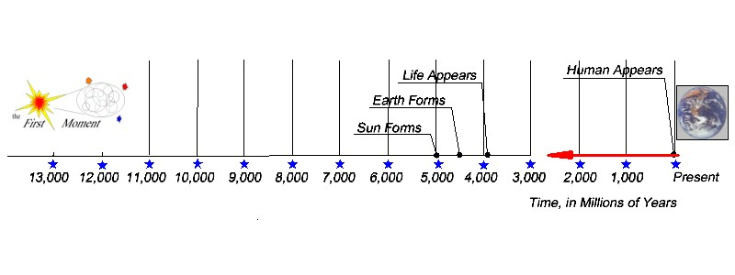
Interval Scale Example - Time
We lack a precise measure of when time began
So we measure time using an arbitrary “0” point
Years are measured since an arbitrary date
Microsoft Excel dates are measured in days since 12/31/1899
Scientists often measure time in years backwards from the present
http://thestoryofouruniverse.com/wp-content/uploads/Time-scale-2a.jpg

Slide 103
Other Examples of Interval Scales
Temperature (on Centigrade or Fahrenheit scale)
Map coordinates (longitude or latitude)
Map direction (degrees from North)
Note: a common error is to assume you can compute ratios for items in an interval scale.
See next slide for more information on this.

Slide 104
Computing Ratios for Interval Scales
The ratio between two items on an interval scale cannot be determined
But you can determine the ratios between differences
Example: the parent’s age could be twice that of the child’s:
Each age is the difference between the current date and the date of birth

Slide 105
Ratio Scales
Characteristics
Nominal
Ordinal
Interval
Ratio
Scale

Slide 106
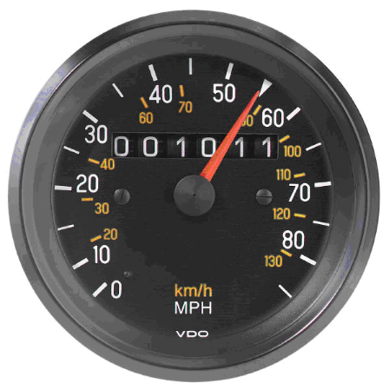
Ratio: There is a fixed distance between consecutive sequence members, AND multiplication is meaningful
This means that ratios are meaningful
Examples:
Size
Weight
Length
Duration
Electric Charge
60 mph is twice as fast as 30 mph
http://www.sixsigmatrainingconsulting.com/wp-content/uploads/2010/10/ratio-scale.bmp
Note that there is a “true 0” value

Slide 107
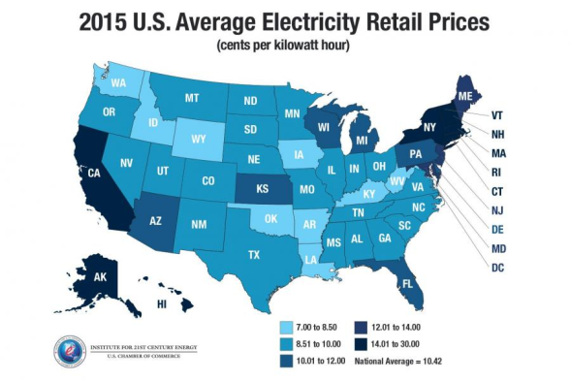


With a Ratio Scale We Can Compute an Average or Mean
Because we can multiply and divide
https://www.uschamber.com/sites/default/files/styles/article_gallery/public/ei_electricityratesmap4.5.16.jpg?itok=DDSLVlpu
http://homevestors.com/wp-content/uploads/Average-Home-Size.png
https://www.google.com/url?sa=i&rct=j&q=&esrc=s&source=images&cd=&cad=rja&uact=8&ved=0ahUKEwiXhcuLzNTSAhVM34MKHQ9UCNYQjRwIBw&url=http%3A%2F%2Fnewsroom.aaa.com%2F2016%2F08%2Faverage-gas-prices-holding-steady-begin-august%2F&psig=AFQjCNFYj2pTtSvClpmXIAwWf_1pFq-aeg&ust=1489532668700886

Slide 108
One Other Scale is Often Used in Data Analysis

Slide 109
Absolute Scales
Absolute: all mathematical operations are meaningful
Square root
Exponentiation
Etc.
In some definitions, only positive values are permitted
(i.e., there is an absolute 0, marking the starting point of the scale)

Slide 110

Test Yourself – What Scale is Clothing Size?
https://rules.ssw.com.au/PublishingImages/size-stories-bad-example.jpg

Slide 111
Scales - Summary
Characteristics | Nominal | Ordinal | Interval | Ratio
Categorization, Classification | ☑ | ☑ | ☑ | ☑
Mode (most frequent) | ☑ | ☑ | ☑ | ☑
Order, Comparison, Sorting |  | ☑ | ☑ | ☑
Median (middle) |  | ☑ | ☑ | ☑
Fixed Distance, Add, Subtract |  |  | ☑ | ☑
Ratio of differences |  |  | ☑ | ☑
Multiply and Divide, Ratio |  |  |  | ☑
True 0 |  |  |  | ☑
Mean |  |  |  | ☑

Slide 112
Misuse of Scales

Slide 113
Example - Assigning a Scale to Test Failures
{Blue, Green, Yellow, Red}
This is an ordinal scale
It provides a ranking but not ratios
There is not a fixed difference between values
The difference between “red” and “yellow” is not comparable to the difference between “yellow” and “green”
It makes no sense to add, subtract, multiply or divide the values.
Fewest Most

Slide 114
But Suppose we Replace with a Numeric Scale
4 = Blue 3 = Green
2 = Yellow 1 = Red
We are tempted to make meaningless or misleading statements like these:
“The average test error improved from 2.2 to 3.1”
“The average test error improved by 47%”

Slide 115

Another Example – Customer Survey
The average response from our customers is “good” [on a scale of very poor, poor, good, very good]
But the scale is not a ratio scale (or even an interval scale), so what does “average” mean?
Does “half very good and half poor” mean “good”?
http://www.brecoflex.com/wp-content/uploads/2016/10/survey.jpg

Slide 116
Assigning Numbers Can be Misleading
The properties of the number system may not necessarily apply to the attribute being measured
Consider the attribute “temperature”:
Scale Yesterday Today
Centigrade 0 18
Fahrenheit 32 64
Is it twice as hot today as it was yesterday?

Slide 117
Twice as ...
“Twice as” is a meaningful concept for numbers
It is not necessarily a meaningful concept for temperature
Because centigrade and Fahrenheit are interval scales, not ratio scales
The error we make is assuming that properties of the number system apply to the attribute being measured
Footnote: “twice as” is a meaningful concept for temperature measured on the Kelvin scale because the volume of a gas is proportional to its temperature on that scale.

Slide 118
A Very Common Example: Student Grade Point Average
Student 1
Student 2
Grade Point Average is an example of a Descriptive Statistic.
Not technically accurate, but does give a useful indication.
B – 3 points
B – 3 points
B – 3 points
B – 3 points
B – 3 points
Average: 15/5 = 3.0
A – 4 Points
A – 4 Points
B – 3 Points
B – 3 Points
D – 1 Point
Average: 15/5 = 3.0
Are These Students Really Equal?

Slide 119
Contents
Definitions
Scales
Basic Analysis Approaches
Statistical Distributions
Other Statistical Concepts

Slide 120

What Do We Have, After Data Collection?
We have a collection of data values,
known as a dataset or a batch.
These values are measurements
of
attributes
of
entities

Slide 121

What Do We Want to Know?
Characteristics of attributes / entities of the same type
Relationships between attributes / entities of the same or different types
Examples:
Which method is faster?
How many defects?
Do effective peer reviews reduce customer complaints?

Slide 122

The First Step is to Organize the Data for Analysis
First, we refine & compress the data
Eliminate duplicates, errors, etc.
Compute totals, sort data, etc.
Perform appropriate data compression
Then, we compute various derived measures (computations)
Thenounproject.com
Derived Measure
Derived Measure
Derived Measure
Base Measure
Base Measure
Base Measure
Base Measure
Base Measure

Slide 123
Examples of Derived Measures
Units Per Month
LOC per
Staff Month
$ per Line of Code
Units
Produced
Months
Head-
count
Lines
of Code
$ Spent
Exactly what derived measures we want is determined by our metric selection process (based on our information needs).

Slide 124


The Next Step is Analysis
One option is to simply look at the data:
We can look at the data as we have it
We may want to sort the data or do other simple processing to make sense of it

Slide 125

Another Option is to Graph the Data
Often, a graph or chart makes it very easy to see what the data are telling us.

Slide 126



But Often There is Too Much Data or the Relationships Are Not So Easy to See
Statistical methods are often helpful in situations like these

Slide 127
Contents
Definitions
Scales
Basic Analysis Approaches
Statistical Distributions
Other Statistical Concepts

Slide 128
Statistical Techniques Help Us Deal with Many Situations
Statistical techniques can often be used to describe the attributes and relationships
Examples:
High and Low values (and how often each occurs)
Average (Mean), Median and Mode
Mathematical relationships between values
For example, if you double the number of programmers, how much do you reduce the schedule?
Patterns of values
For example, do most defects result from errors in requirements, errors in design, or errors in coding?
Overall distribution of values

Slide 129
Distributions
Suppose you evaluate 30 students on their programming ability and come up with the following values:
Overall Ability | Total | Percent
Very Poor | 3 | 10.0%
Poor | 6 | 20.0%
Average | 12 | 40.0%
Good | 7 | 23.3%
Very Good | 2 | 6.6%
Total | 30 | 100%
Since all students are accounted for, this is called a distribution of student ability values.

Slide 130
The Distribution as a Bar Graph

Slide 131
The Distribution as a Histogram
A histogram looks like a bar chart with no spaces between the bars.
Histograms are often used to show distributions.

Slide 132
Probability Distributions
Suppose one student is selected at random from the group of 30.
What is the probability that the student will have any given ability level?
Overall Ability | Total | Probability
Very Poor | 3 | .1
Poor | 6 | .2
Average | 12 | .4
Good | 7 | .233
Very Good | 2 | .066
Total | 30 | 1.0
If you represent the percentage as a probability, this is called a probability distribution of student ability values.

Slide 133

Requirements for a Valid Probability Distribution
A probability distribution is the assignment of probability values to each of the possible outcomes
The probabilities must be numbers between 0 and 1
The probabilities must add up to 1
The probability distribution represents the likelihood that a randomly chosen value will have a given outcome.

Slide 134
Calculating Probability of Other Situations
Suppose you want to know if a randomly chosen student will be at least average in ability.
Overall Ability | Total | Probability
Very Poor | 3 | .10
Poor | 6 | .20
Average | 12 | .40
Good | 7 | .233
Very Good | 2 | .066
Total | 30 | 1.0
Add up the probabilities:
.40 + .233 + .066 = .70
These are average or higher
The probability of a student being at least average is .70

Slide 135
Uniform Distribution
If all events are equally likely, this is called a uniform distribution.
If there are N options, the probability of any of them is 1/N

Slide 136
Suppose There are Many Possible Values
Example: The ages of the software development staff
Total staff size is 200 people
Range of ages is from 18 to 72
There are 55 possible values
Age | Total | Probability
18 | 1 | .005
19 | 0 | .000
20 | 2 | .010
21 | 0 | .000
22 | 1 | .005
… | … | …
Total | 200 | 1.0
There would be a
very long list
and
very small probabilities
for most cases.
This might be very cumbersome to analyze.

Slide 137
Graph of Probability Distribution – Line Chart

Slide 138
Graph of Probability Distribution – Bar Chart

Slide 139
What If There Are an Infinite Number (or a very large number) of Possible Values
Examples:
Number of lines of code in each software product.
Range: 11 to 128,045
In this case, it could be meaningless to have a separate probability for each possible value.
Solution 1: Discretization
Divide the possibilities into discrete ranges that make sense for your purposes
Solution 2: Continuous Function
Represent the values with a continuous function

Slide 140
Discretization
Divide the list into discrete intervals
Age Range | Total | Probability
20 or less | 1 | .005
21-30 | 39 | .195
31-40 | 62 | .310
41-50 | 45 | .225
51-60 | 28 | .140
61-70 | 22 | .110
Over 70 | 3 | .015
Total | 200 | 1.0
For many purposes, these categories would be useful and having only 7 categories makes analysis a lot easier than having 55 of them.

Slide 141
Bar Graph of Discretized Distribution Data for Programmer Age
Note that this discretized graph tells us things that were harder to see before.

Slide 142
Same Graph Using a Line Chart
What if there were a mathematical function that produced a curve similar to this?

Slide 143

Use of a Continuous Distribution Function
For very large numbers (or infinite possibilities), it is sometimes convenient to use a continuous function whose shape approximates the distribution of the data.
The area under the curve is equal to 1.0 – the sum of all probabilities.

Slide 144
Advantages and Drawbacks of Continuous Functions
Advantages
Many mathematical and statistical analyses can be performed on the functions
You can often make good predictions
Or combine multiple independent variables and determine their relationships
Drawbacks
You cannot draw conclusions about individual values
For example: what is the probability that a programmer is exactly 34.25 years old?
You must draw conclusions about ranges of values
For example: what is the probability that a programmer is between 34 and 35 years old?

Slide 145



Normal Distribution (Bell Curve)
This is a widely used continuous distribution because many phenomena fit this shape.
$μ$ is the mean or average value

Slide 146

Normal Distribution Variations
By Inductiveload - self-made, Mathematica, Inkscape, Public Domain, https://commons.wikimedia.org/w/index.php?curid=3817954

Slide 147

Example Bell Curve Approximates Data

Slide 148

Real Data With Approximately Normal Distribution

Slide 149

Uses of Normal Distribution (1 of 2)
If the data are distributed in a pattern that is similar to normal distribution, we can often reach conclusions about the data from known facts about the normal distribution
This happens often with many natural phenomena
For example: height

Slide 150
Uses of Normal Distribution (2 of 2)
Many statistical concepts are easy to explain using the normal distribution
Because it has many very convenient statistical and mathematical properties

Slide 151


Normal Distribution Variants
The Normal Distribution is a type of Gaussian Distribution
The Gaussian Distribution is a type of Elliptical Distribution
There are many ways to modify a Gaussian distribution to fit specific datasets
For some situations, an Elliptical distribution will fit the data
Various Gaussian Distributions
Various Elliptical Distributions

Slide 152

Other Examples of Continuous Distributions
For many phenomena there are continuous distributions that approximate the actual distributions.
You find out using curve fitting techniques

Slide 153


Many Natural Phenomena Fit the Chi Square Distribution (C2 or ²)
C2 Distribution
Variations on C2
Unlike the normal distribution, C2 is constrained to have no negative values.

Slide 154
Contents
Definitions
Scales
Basic Analysis Approaches
Statistical Distributions
Other Statistical Concepts

Slide 155

Central Tendency Measures
A Measure of Central Tendency
is a
single value
that
attempts to describe a set of data
by
identifying the central position within that set of data.
Slideshare.net
These are also sometimes called
summary statistics
or
measures of central location

Slide 156
Mode, Median and Mean (Central Tendency Measures)
Mode: The value that appears most often
Median: The value of the middle item
Mean ( or ): The average of all values
Given these values: 1,2,2,3,4,7,9
Term | Description | Example | Result
Mean | Sum / Total Number of Values | (1+2+2+3+4+7+9)/7 | 4
Median | Middle value | 1,2,2,3,4,7,9 | 3
Mode | Most Frequent Value | 1,2,2,3,4,7,9 | 2
Source: Wikipedia

Slide 157

Mode, Median and Mean for Various Distributions

Slide 158

Example of Skewed Distribution

Slide 159


Notes about Mode (1 of 2)
There can be no mode or more than one mode
no mode - Bimodal - Multimodal
When there is a lot of data and there are several local maximum points, each is considered a mode
i.e., any relative high point or peak in the data may be considered a mode.

Slide 160

Notes about Mode (2 of 2)
The mode can be determined for data using nominal, ordinal, interval, ratio and absolute scales
Mean & median require higher scales
Mean
Median
Mode

Slide 161

Notes about Mode, Median and Mean
For normally distributed data, these three are equal
For other distributions they may not be.
So one way to tell if the normal distribution is a possible fit to your data is to compute the mode, median and mean and see if they are the same.

Slide 162

Measures of Dispersion
A Measure of Dispersion
is a
single value
that
attempts to describe a set of data
by
identifying the spread of values within that set of data.
Ghhomeworktcif.gloriajohnson.us
The most common measures of dispersion are:
Range
Variance, and
Standard deviation

Slide 163

The Range
The Range is the distance between the largest and the smallest values in a set of data
(Requires an interval scale)
Web.cs.wpi.edu

Slide 164
The Variance (requires a ratio scale)
In statistics, particularly when looking at probability distributions,
the Variance is a measure of how far a set of numbers is spread out.
This is also known as the dispersion or variation.
Variance = 0
means all the numbers are the same
Variance = a small number
means all the numbers are close to each other
Variance = a large number
Means the numbers are widely dispersed

Slide 165



The Standard Deviation () (square root of the variance)
The Standard Deviation (denoted by the symbol $σ$ or “sigma”) is another measure used to represent the amount of variation or dispersion of a set of data values
$μ$ is the mean or average value

Slide 166

Standard Deviation & Variance
If the standard deviation or variance is small, it means the data values are very close together (blue curve)
If the standard deviation or variance is large, it means the data values are dispersed (red curve)

Slide 167


Calculations for a Discrete, Random Variable x
Suppose you have an ordered collection of numbers, X, on a ratio scale
And suppose x is a random member of the collection
$μ$ = mean or average value
x_{i} = i^{th} possible value
p_{i} = probability that x has the value x_{i}
Variance =
$σ$ = $\sqrt{Variance}$
There are many uses for these calculations when doing statistical analysis of measured data

Slide 168


Alternative Calculations for Variance
Suppose you have an ordered collection of numbers, X, on a ratio scale
And suppose N is the number of members (the size) of the collection
$μ$ = mean or average value
x_{i} = i^{th} value
Variance =
N
$σ$ = $\sqrt{Variance}$
For some data sets, this formula for variance may experience overflow, underflow or other calculation instabilities due to the sums of squares required. See “Algorithms for calculating variance” on Wikipedia.

Slide 169

Any Questions?

Slide 170
End of
Lecture

Slide 171
References Part 1
Bourque, P. and R.E. Fairley, eds., Guide to the Software Engineering Body of Knowledge, Version 3.0, IEEE Computer Society Press, 2014. ISBN 978-0769551661. Available in PDF format (free) at www.swebok.org.
Crosby, Philip, Quality is Free. New York: McGraw-Hill, 1979. ISBN 0-07-014512-1.
Fenton, Norman and James Bieman, Software Metrics: A Rigorous and Practical Approach, Third Edition, Chapman and Hall, 2014. ISBN 978-1439838228.
Juran, Joseph M., Juran on Quality by Design: The New Steps for Planning Quality into Goods and Services. Free Press, 1992. ISBN-13: 978-0029166833.
Project Management Institute, SWX – The Software Extension to the PMBOK Guide Fifth Edition, Project Management Institute, 2013. ISBN 978-1628250138.
Weinberg, Gerald M., Quality Software Management, Volume 1, Systems Thinking, Dorset House, New York, 1992. ISBN: 0-932633-22-6.

Slide 172
References Part 2
Devore, Jay, N. Farnum, and J. Doi, Applied Statistics for Engineers and Scientists, 3nd Edition, Thompson, 2013. ISBN 978-1133111368.
Fenton, Norman and James Bieman, Software Metrics: A Rigorous and Practical Approach, Third Edition, Chapman and Hall, 2014. ISBN 978-1439838228.
Stevens, S. S., "On the Theory of Scales of Measurement". Science (7 June 1946). 103 (2684): 677–680.

